Slide 1
RATHINAM
CENTRE OF EXCELLENCE
Database Management System
SQL Datatypes and Operators
by
Mrs.B. Sharmila
Technical Trainer

Slide 2
Introduction to SQL Datatypes
The data type of a column defines what values the column can hold.
COLUMN = NAME + DATATYPE;
An SQL developer must decide what type of data that will be stored inside each column when creating a table.
The data type is a guideline for SQL to understand what type of data is expected inside of each column.
ROLL_NO | NAME
1 | RAM
2 | RAMESH
3 | SUJIT
4 | SURESH
SQL Datatypes and Operators

Slide 3
Types of SQL Datatypes
Character data types
Integral data types
Non-Integral data types
Date and Time Data Types

Slide 4
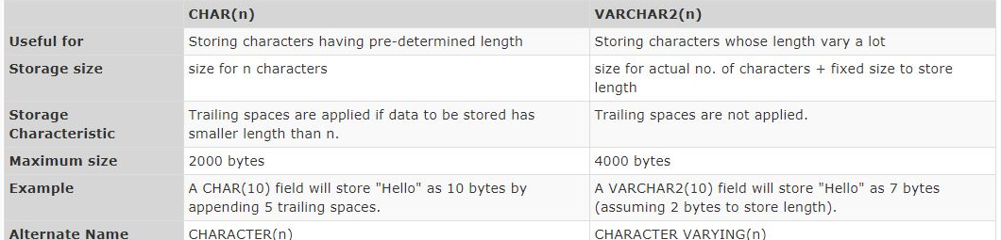
Character - SQL Datatypes
SQL supports two character data types for storing printable and displayable characters.
They are used for storing information like name, city, description etc.
SQL Datatypes and Operators

Slide 5
Integral data types - SQL Datatypes
SQL supports SMALLINT, INTEGER, INT and BIGINT data types that are used for storing whole numbers.
BIT(size) | A bit-value type. The number of bits per value is specified in size. The size parameter can hold a value from 1 to 64. The default value for size is 1.
TINYINT(size) | A very small integer. Signed range is from -128 to 127. Unsigned range is from 0 to 255. The size parameter specifies the maximum display width (which is 255)
BOOL | Zero is considered as false, nonzero values are considered as true.
BOOLEAN | Equal to BOOL
SMALLINT(size) | A small integer. Signed range is from -32768 to 32767. Unsigned range is from 0 to 65535. The size parameter specifies the maximum display width (which is 255)
MEDIUMINT(size) | A medium integer. Signed range is from -8388608 to 8388607. Unsigned range is from 0 to 16777215. The size parameter specifies the maximum display width (which is 255)
INT(size) | A medium integer. Signed range is from -2147483648 to 2147483647. Unsigned range is from 0 to 4294967295. The size parameter specifies the maximum display width (which is 255)
INTEGER(size) | Equal to INT(size)
BIGINT(size) | A large integer. Signed range is from -9223372036854775808 to 9223372036854775807. Unsigned range is from 0 to 18446744073709551615. The size parameter specifies the maximum display width (which is 255)
SQL Datatypes and Operators

Slide 6
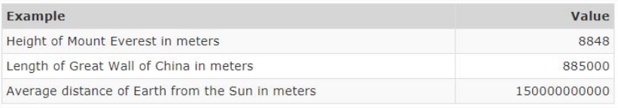
Integral data types - SQL Datatypes
Some real-life examples of values are provided below:
SQL Datatypes and Operators

Slide 7
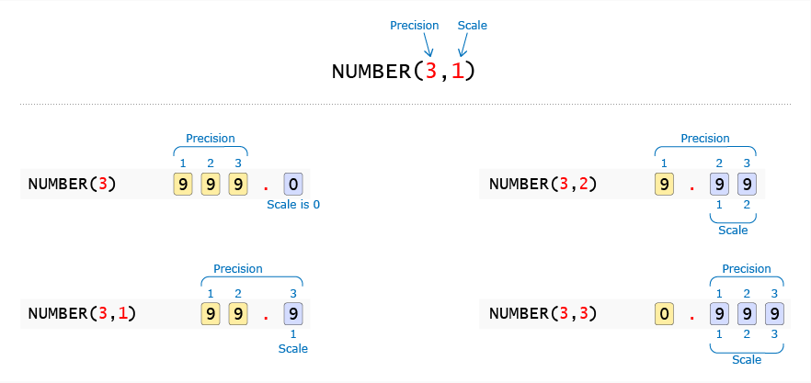
NON Integral data types - SQL Datatypes
Non integral data types have an integer part and a fractional part.
Either NUMERIC, DECIMAL or NUMBER data types can be used to store non integral numbers.
SQL Datatypes and Operators

Slide 8
NON Integral data types - SQL Datatypes
Scale
Precision
NUMERIC ( 3 , 1 )
9
9
9
0
NUMERIC ( 3 ) .
Precision 3
Scale 0
Precision 3
9
NUMERIC ( 3 , 1 )
9
.
9
Scale 1
Precision 3
9
9
9
NUMERIC ( 3 , 2 )
.
Scale 2
SQL Datatypes and Operators

Slide 9
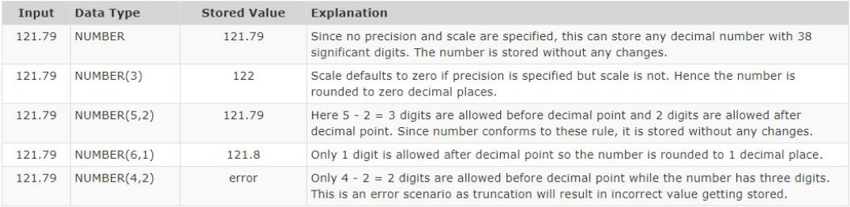
NON Integral data types - SQL Datatypes
Scale is the number of digits allowed after the decimal point. i.e. digits after the decimal point.
Precision is the total number of significant digits i.e. digits before and after the decimal points.
If Scale is not provided then NUMBER datatype can be used to store integral values.
SQL Datatypes and Operators

Slide 10
Date and Time data types - SQL Datatypes
For storing date and large objects, SQL supports the following data types:
Data type | Description
DATE | A date. Format: YYYY-MM-DD. The supported range is from '1000-01-01' to '9999-12-31'
DATETIME(fsp) | A date and time combination. Format: YYYY-MM-DD hh:mm:ss. The supported range is from '1000-01-01 00:00:00' to '9999-12-31 23:59:59'. Adding DEFAULT and ON UPDATE in the column definition to get automatic initialization and updating to the current date and time
TIMESTAMP(fsp) | A timestamp. TIMESTAMP values are stored as the number of seconds since the Unix epoch ('1970-01-01 00:00:00' UTC). Format: YYYY-MM-DD hh:mm:ss. The supported range is from '1970-01-01 00:00:01' UTC to '2038-01-09 03:14:07' UTC. Automatic initialization and updating to the current date and time can be specified using DEFAULT CURRENT_TIMESTAMP and ON UPDATE CURRENT_TIMESTAMP in the column definition
TIME(fsp) | A time. Format: hh:mm:ss. The supported range is from '-838:59:59' to '838:59:59'
YEAR | A year in four-digit format. Values allowed in four-digit format: 1901 to 2155, and 0000. MySQL 8.0 does not support year in two-digit format.
SQL Datatypes and Operators

Slide 11
Other data types - SQL Datatypes
Data type | Description
CLOB(Character Large Object ) | Storing large character based data which cannot be stored in VARCHAR2 due to its 4000 bytes size limit.
BLOB ( Binary Large Object ) | Storing large binary data like movies, images with size up to 4 GB.
cursor | It is used to store a reference to cursor object
XML | It is used to store XML formatted data and we can store maximum 2GB data
table | It is used to store table result set for processing at a later time
uniqueidentifier | It is used to store globally unique identifier (GUID)
sql_variant | It is used to store values of various sql supported data types except text,ntext, varchar(max), xml, etc… We can store a maximum of 8000 bytes
SQL Datatypes and Operators

Slide 12
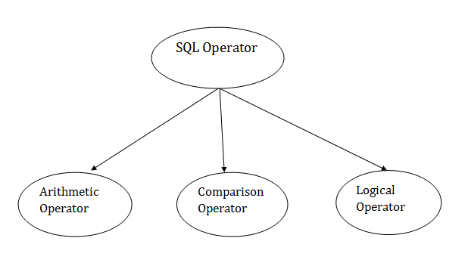
Introduction to SQL Operators
Operators are defined as symbols that help us to perform specific mathematical and logical computations on operands.
In other words, we can say operators as operator operates the operands.
SQL Datatypes and Operators

Slide 13
Arithmetic Operators - SQL Operators
S.No | Operators | Description
1 | + | The addition is used to perform an addition operation on the data values.
2 | – | This operator is used for the subtraction of the data values.
3 | / | This operator works with the ‘ALL’ keyword and it calculates division operations.
4 | * | This operator is used for multiply data values.
5 | % | Modulus is used to get the remainder when data is divided by another.
SQL Datatypes and Operators

Slide 14
Demo – Arithmetic Operators
SQL Datatypes and Operators

Slide 15
Comparison Operators - SQL Operators
S.No | Operators | Description
1 | = | Equal to.
2 | > | Greater than.
3 | < | Less than.
4 | >= | Greater than equal to.
5 | <= | Less than equal to.
6 | <> | Not equal to.
SQL Datatypes and Operators

Slide 16
Demo – Comparison Operators
SQL Datatypes and Operators

Slide 17
Logical Operators - SQL Operators
The Logical operators are those that are true or false. They return true or false values to combine one or more true or false values.
S.No | Operators | Description
1 | AND | Logical AND compares between two Booleans as expressions and returns true when both expressions are true.
2 | OR | Logical OR compares between two Booleans as expressions and returns true when one of the expressions is true.
3 | NOT | Not takes a single Boolean as an argument and changes its value from false to true or from true to false.
SQL Datatypes and Operators

Slide 18
Demo – Logical Operators
SQL Datatypes and Operators

Slide 19
Other Special Operators - SQL Operators
S.No | Operators | Description
1 | ALL | ALL is used to select all records of a SELECT STATEMENT. It compares a value to every value in a list ofof results from a query. The ALL must be preceded by the comparison operators and evaluates to TRUE if the query returns no rows.
2 | ANY | ANY compares a value to each value in a list of results from a query and evaluates to true if the result of an inner query contains at least one row.
3 | BETWEEN | The SQL BETWEEN operator tests an expression against a range. The range consists of a beginning, followed by an AND keyword and an end expression.
4 | IN | The IN operator checks a value within a set of values separated by commas and retrieves the rows from the table which are matching.
5 | EXISTS | The EXISTS checks the existence of a result of a subquery. The EXISTS subquery tests whether a subquery fetches at least one row. When no data is returned then this operator returns ‘FALSE’.
6 | LIKE | The LIKE operator is used to select the values that match the patterns specified in the query.
SQL Datatypes and Operators

Slide 20
Demo – Special Operators
SQL Datatypes and Operators

Slide 21
Operator Precedence - SQL Operators
Level | Operators
1 | * (Multiplication), / (Division), % (Modulus)
2 | + (Positive), - (Negative), + (Addition), + (Concatenation), - (Subtraction)
3 | =, >, <, >=, <=, <>, !=, !>, !< (Comparison operators)
4 | NOT
5 | AND
6 | ALL, ANY, BETWEEN, IN, LIKE, OR, SOME
7 | = (Assignment)
SQL Datatypes and Operators

Slide 22
QUIZ
1. Which data type can be used to store weight of a person in kilograms with accuracy of 1 gram. As per wikipedia, Jon Brower Minnoch was the heaviest human ever recorded with a weight of 635kg.
NUMBER(3,3)
NUMBER(3,2)
NUMBER(6,2)
NUMBER(6,3)
2. What is the maximum value that can be stored in NUMERIC(4,2)?
9999.99
99.9999
99.99
9.99
3. Which of the below statements are TRUE? [Choose any TWO]
Scale denotes number of digits allowed after decimal point
Precision denotes number of digits allowed before decimal point
SQL performs rounding if user attempts to store a value that has higher scale than the data type
SQL performs truncation if user attempts to store a value that has higher precision than the data type
SQL Datatypes and Operators

Slide 23
QUIZ
4. Select the most suitable data type possible for the given column.
Column Name: Price
Description: Cost of an item in rupees and paise
Example: 200.21
VARCHAR2(50)
NUMBER
NUMBER(5,2)
NUMBER(6)
5. Select the most suitable data type possible for the given column.
Column Name: Meeting_Time
Description: Time and date of the meeting
Example: 2014/01/01 10:00 AM
DATE
TIMESTAMP
BLOB
NUMBER
SQL Datatypes and Operators

Slide 24
QUIZ
6. Choose the most suitable data type possible for the given column.
Column Name: Profile_Image
Description: Image of the employee
CLOB
BLOB
7. Choose the most suitable data type possible for the given column.
Column Name: Book_Title
Description: A text string
Example: Winning
VARCHAR2(50)
CHAR(11)
INTEGER
SQL Datatypes and Operators

Slide 25
QUIZ
8. Choose the most suitable data type possible for the given column.
Column Name: Gender
Description: A single character gender code, M or F
Example: M
CHAR(11)
VARCHAR2(50)
CHAR(1)
9. Choose the most suitable data type possible for the given column.
Column Name: PIN_Code
Description: Six digit numeric PIN code for any address in India
Example: 560100
INTEGER
CHAR(11)
NUMBER(6)
VARCHAR2(50)
10 . The numerical values of two ___ of the ___ table can be easily subtracted using SQL Subtraction Operator.
Rows, same
Columns, same
Rows, different
Columns, different
SQL Datatypes and Operators

Slide 26
QUIZ
11. Which operator is used to compare a value to a specified list of values?
A.BETWEEN
B.ANY
C.IN
D.ALL
12. When an expression includes ___ SQL operator(s), the sequence in which they are evaluated is known as the SQL operator's precedence.
0
1
Multiple
NULL
13 . Select the correct order of precedence among the following?
OR > NOT > + > **
NOT > OR > ** > +
** > + > OR > NOT
** > + > NOT > OR
SQL Datatypes and Operators

Slide 27
QUIZ
14. Using which SQL Comparison Operator can we find the data that matches our query?
SQL Not Equal Operator (!=)
SQL Equal Operator (=)
SQL Greater Than Operator (>)
SQL Less Than Operator (<)
15. In LIKE clause, to represent a zero, a character, or a number of characters ___ is used.
/
_
*
%
16 . In LIKE clause, to represent a single character, _____ is used.
-
_
!
&
SQL Datatypes and Operators

Slide 28
QUIZ
17. What does the following statement do?
WHERE CustomerName LIKE '%a‘
Finds any values that end with "a"
Finds any values whose second character is "a"
Find any values that contains only two characters ending with "a"
Mysql > Savepoint ini;
18. What does the following statement do?
WHERE CustomerName LIKE 'a%o‘
Finds any values that start with "a" and ends with "o"
Finds any values whose first character is "a" and third character is "o"
Both A. and B.
None of the above
SQL Datatypes and Operators

Slide 29
19 . BETWEEN Operator returns the TRUE value if the column value is –
<=Value1 & >=Value2
<=Value1 & <=Value2
>=Value1 & >=Value2
>=Value1 & <=Value2
20. The SQL Modulus Operator returns the,
Quotient
Percentage
Sum
Reminder

